Slide 1
Digital portfolio
STUDENT NAME : JM.JAMUR NISSA REGISTER NO :2422J1081
NMID : asbru062422j1081 DEPARTMENT : BCA COLLEGE : CHIKKANNA GOVERNMENT ARTs COLLEGE UNIVERSITY : BHARATHIYAR UNIVERSITY

Slide 2
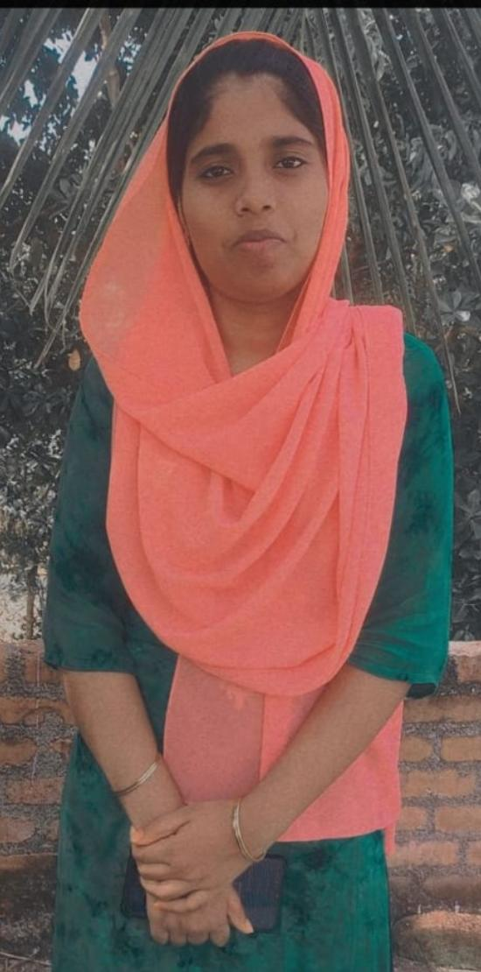
DIGITAL PORTFOLIO
OF
JM.JAMUR NISSA

Slide 3

AGENDA
Problem Statement Project Overview
End Users Tools and Technologies Portfolio design and Layout Features and Functionality Results and Screenshots Conclusion Github Link

Slide 4

PROBLEM STATEMENT
In today’s competitive academic and professional environment, individuals often struggle to present their skills, achievements, and projects in a structured and visually appealing way. Traditional resumes and static documents fail to capture creativity, interactivity, and real-time updates. As a result, employers, clients, and institutions find it difficult to evaluate the full potential of an individual.

Slide 5

Project overview
A personal digital portfolio website Dark theme design with Tailwind CSS Sections: Home, About, Skills, Projects, Contact Responsive design with smooth scrolling Interactive features using JavaScript

Slide 6
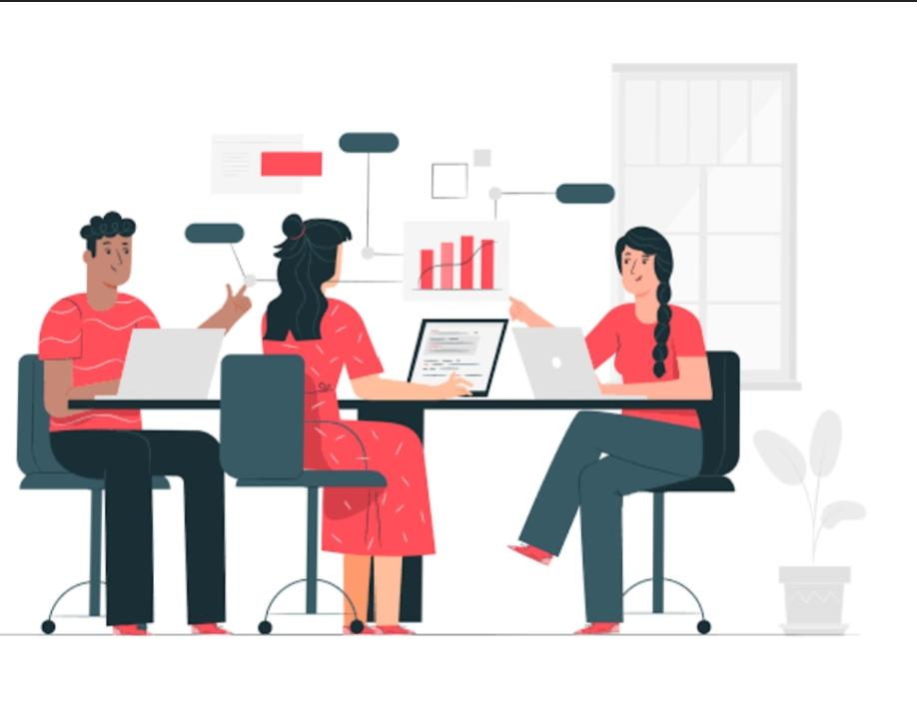
End users
Recruiters & Hiring Managers Teachers / Professors / Academic Evaluators Clients (Freelancing / Personal Projects) Peers & Professional Network General Visitors Tech Communities

Slide 7
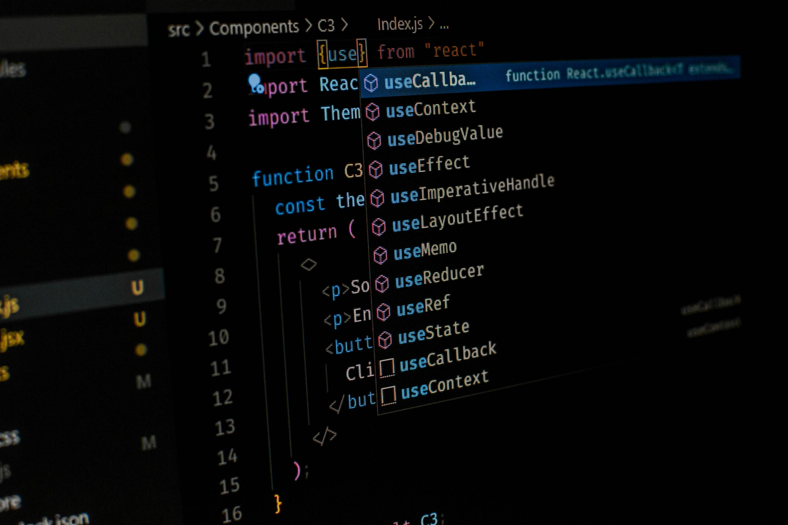
Tools
1.HTML – Structure of the webpage.
Semantic tags (<section>, <nav>, <footer>) Forms (<input>, <textarea>) 2.CSS (via TailwindCSS) – Styling and responsiveness. Tailwind utility classes (bg-dark, flex, grid, px-6, etc.) Custom CSS for animations, gradients, hover effects. 3.Tailwind Config – Extending theme. Custom colors (primary, secondary) Custom font (Inter)
4.Font Awesome
Icons (fa-bars, fa-arrow-up, fa-paper-plane) 5.JavaScript – Interactivity. Mobile menu toggle Smooth scrolling Active link highlighting Back-to-top button Skill bar animations

Slide 8

Techniques
Responsive Design – Using Tailwind’s md: breakpoints. Dark Theme – Custom background + darkMode: ‘class’. Gradient Effects – linear-gradient for text and buttons. Animations – Keyframes (float) + transition effects. Card Hover Effects – Shadow + slight movement on hover. Scroll-Based UI Updates – Active navigation highlighting. Accessibility Basics – Labels for form inputs (<label>). Utility-First CSS – Tailwind reduces writing custom CSS.
I Used The ( codepen) code editor

Slide 9
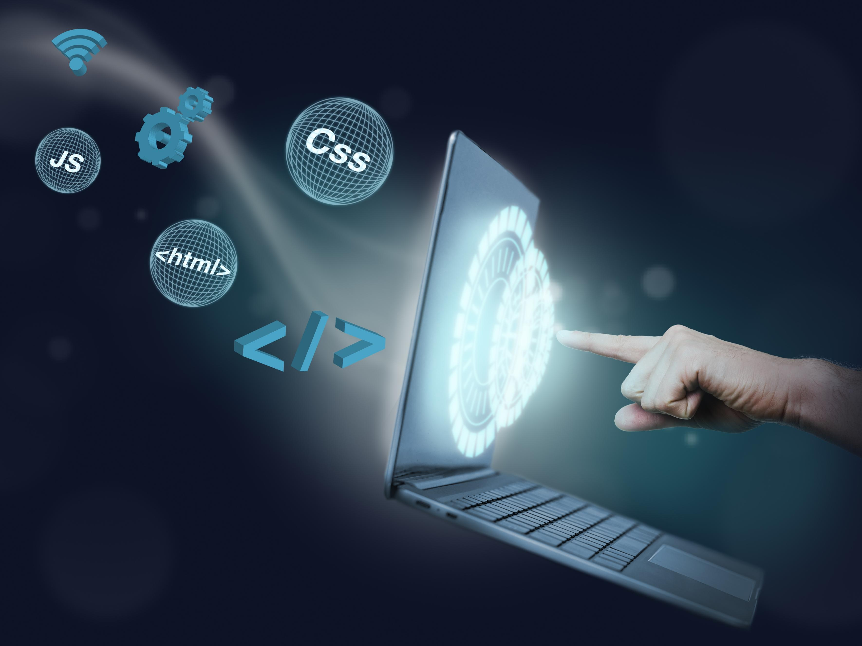
Portfolio design
Dark Theme
Gradient Highlights
Responsive design
Typography and Hierarchy
CTA
Visual balance
Interactive elements

Slide 10
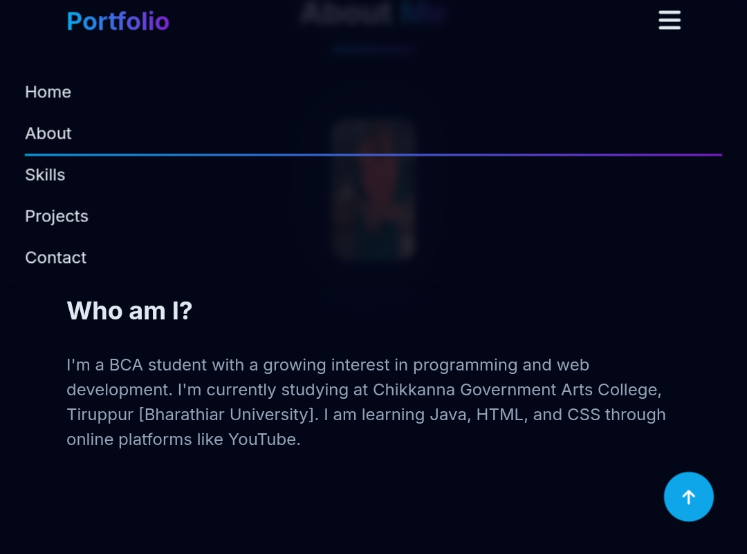
Portfolio layout
1.NAVIGATION
Desktop Menu: Horizontal links.
Mobile Menu: Vertical dropdown.
2. Home Section
Large intro text, role subtitle, short description, CTA button.
3. About Section
Two-column layout: Profile Image (left) + Bio Text (right).
Profile image has a gradient glow effect. 4. Skills Section.
Grid layout → split technical skills. Skill bars show progress with percentages. 5. Projects Section Grid cards (grid-cols-1 md:grid-cols-2 lg:grid-cols-3). Each card has title + short description (expandable in future). 6. Contact Section Form with Name, Email, Subject, Message. Responsive two-column form for larger screens. Large CTA button with icon

Slide 11
Features and functionality
Features
Dark Theme UI
Card hover effect Floating animation Skill bar animation when scrolling into view.
Functionality
Mobile-friendly responsive design. Smooth scrolling Active link highlighting. Skill bars animate on scroll.

Slide 12
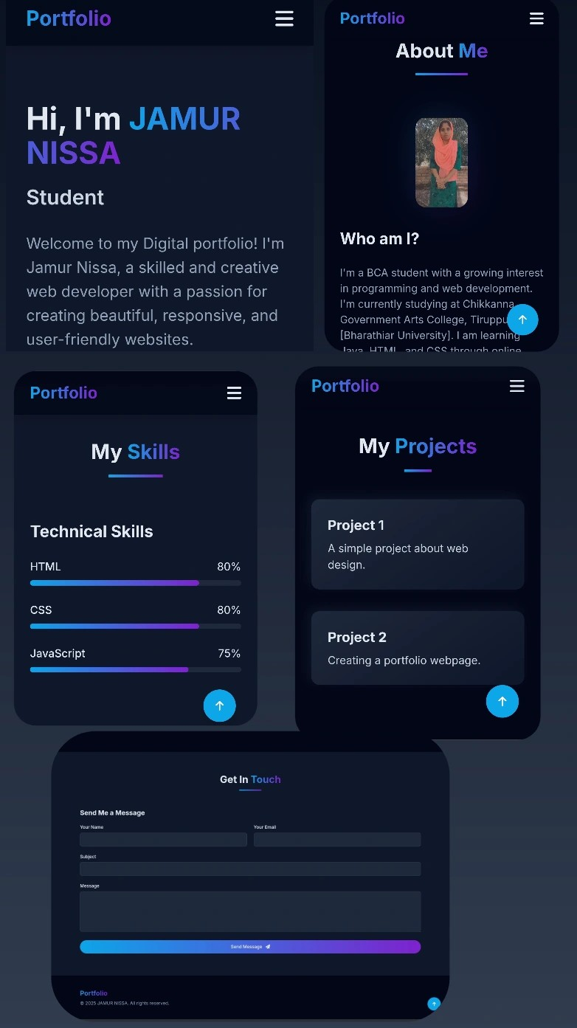
Screenshot of portfolio

Slide 13
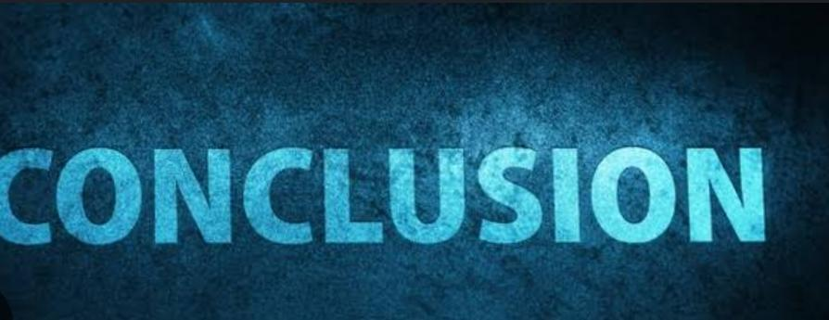
Conclusion
Highlights
Clean and structured HTML Reusable Tailwind classes with custom colors/fonts. Interactive JavaScript for UX (menu toggle, scroll animations). Fully responsive (mobile + desktop).
Summary
This is a well-structured and professional-looking digital portfolio that you can proudly use as your personal website. With a few extra touches (functional contact form, more projects, deployment), it will be portfolio-ready to share with recruiters, professors, or clients.

Slide 14

GitHub links
Stores your code safely online. Tracks every change you make. Lets multiple people work on the same project without conflicts. Makes collaboration easy with pull requests and reviews. Provides tools for automation, security, and project management.
https://github.com/jamurnisa315-star/JAMUR-NISSA-TNSDC-FWWD-DP.git

Slide 15
Thank you

